Slide 1
SCNN Accelerator NoC with Configurable IFmap and Filter Dimensions
Beila Zhao, Chenjie Weng, Yu-Ting Chiu, Jiahui Wang

Slide 2
Outline
Baseline Design
NoC Architecture: Tree and 2x3 Mesh
Processing Element: Fixed Filter Size Calculation
Advanced Design: Configurable IFmap and Filter Size
NoC Architecture: 4x4 Mesh
Processing Element: Multiple Filter Size Calculation
Control Unit: Automatic Instruction Generator

Slide 3
Baseline Design

Slide 4
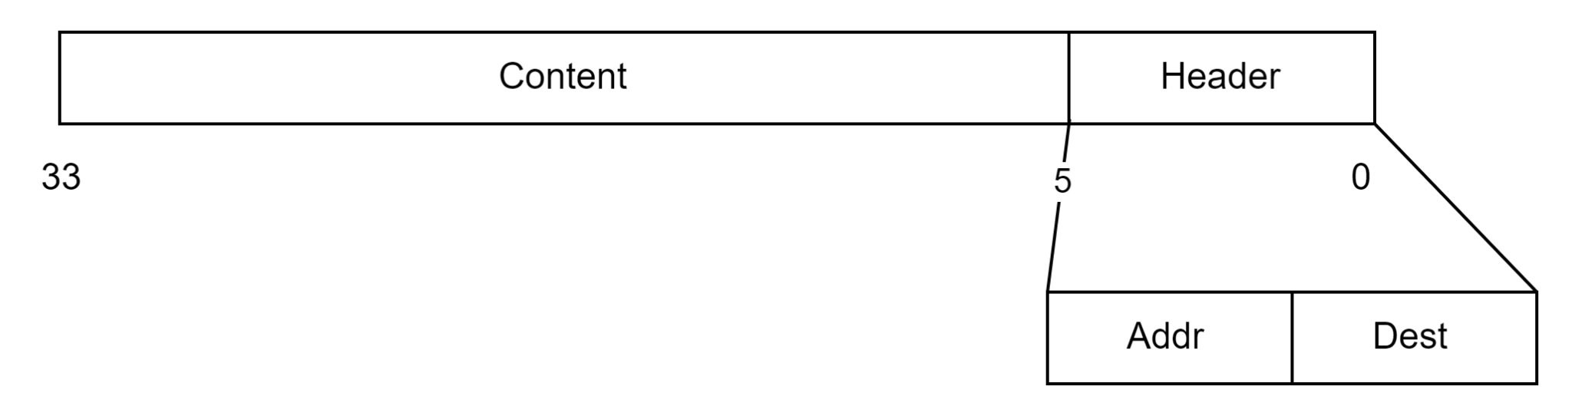
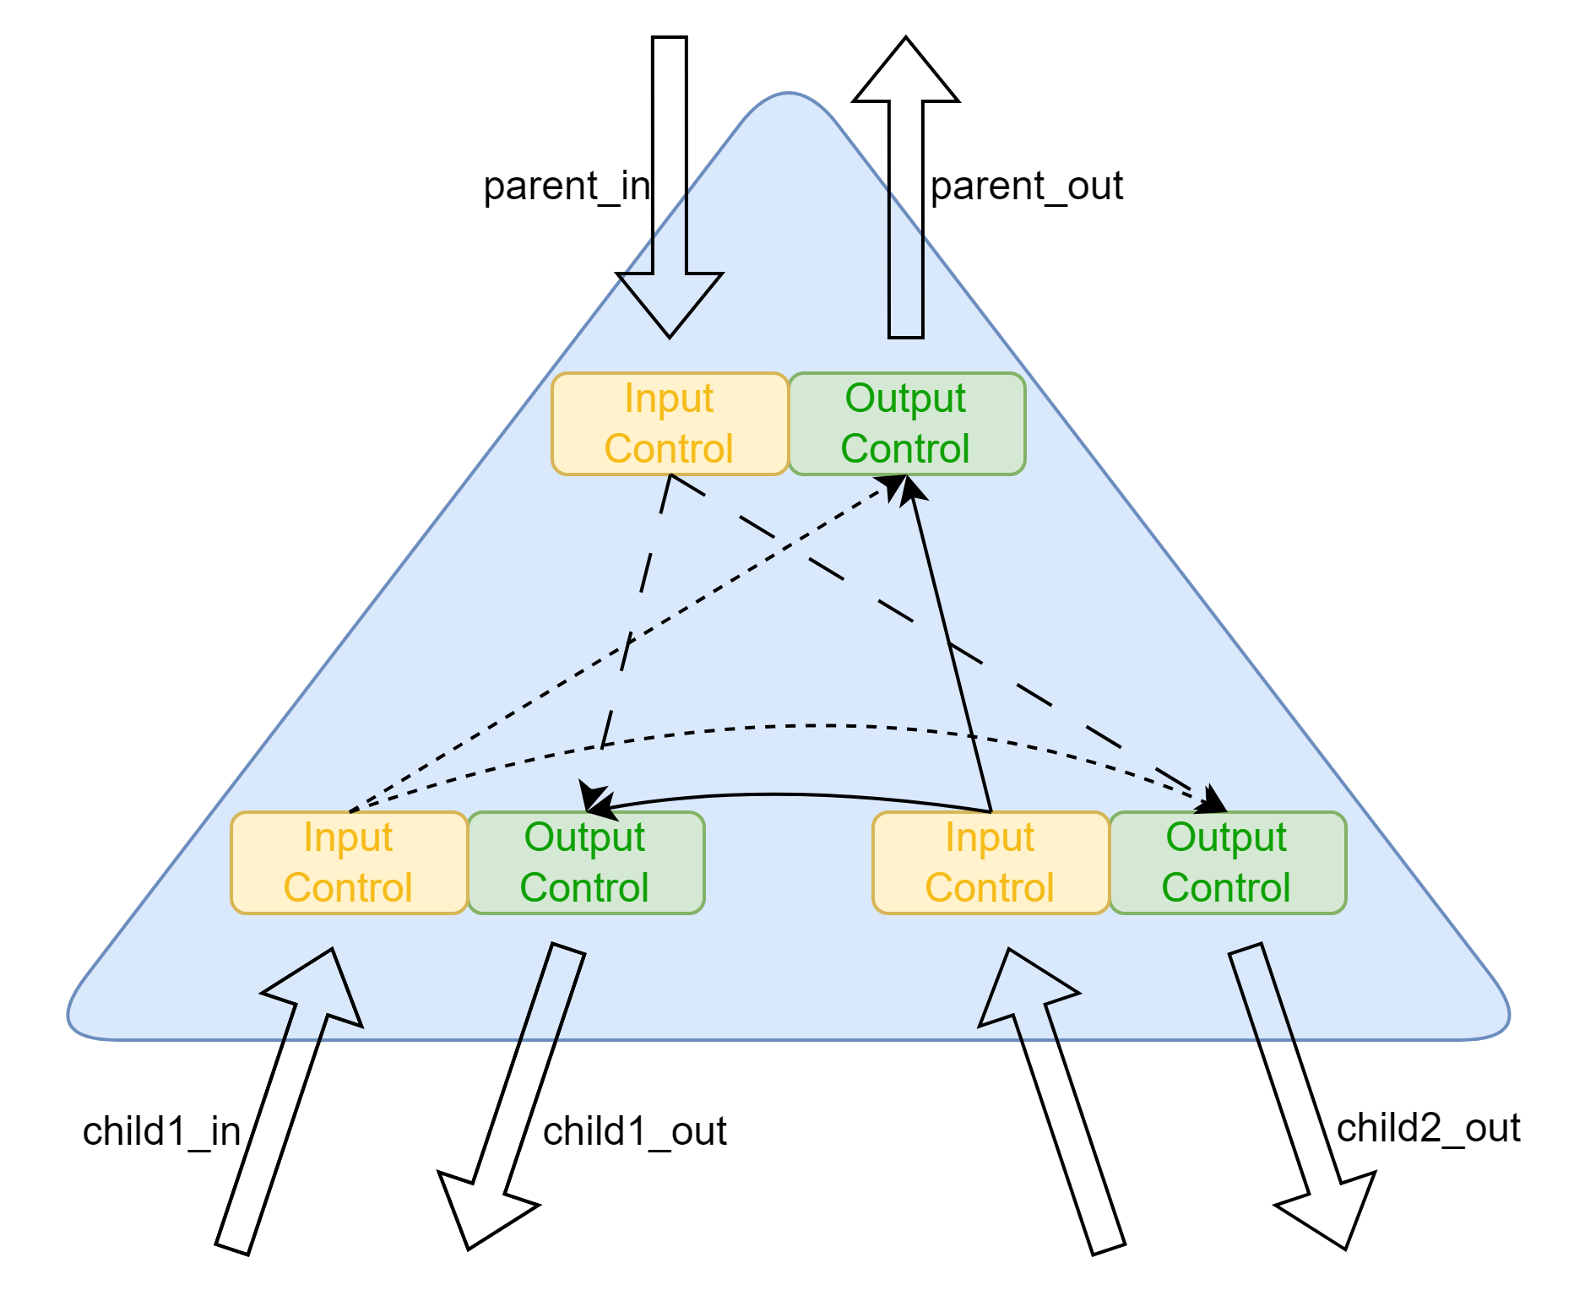
Tree
Parent Node Behavior (IS_PARENT == 1):
Extracts the destination bit based on current tree LEVEL
Routes the packet to:
out1 → left child (if dest_bit is 0)
out2 → right child (if dest_bit is 1)
Child Node Behavior (IS_PARENT == 0):
Calculates mask based on LEVEL to extract relevant bits
Compares masked destination with masked router address
If mismatched → out1 (back to parent)
If matched → out2 (to sibling).

Slide 5
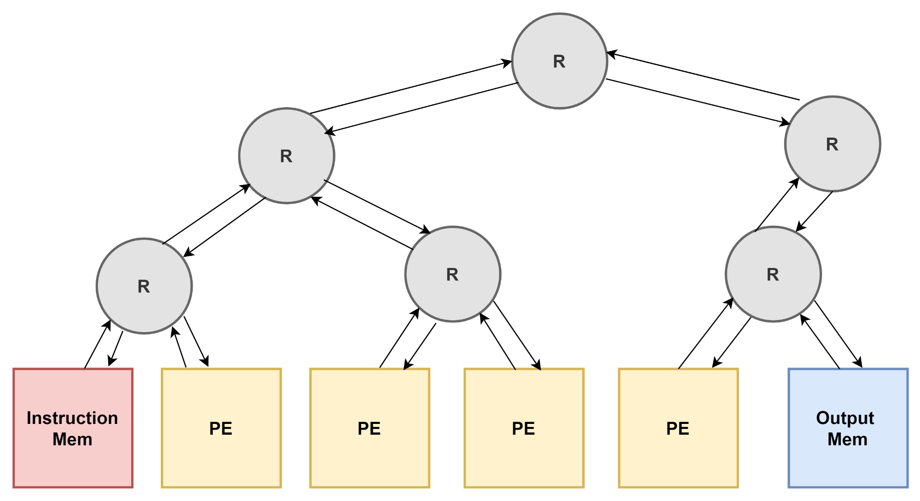

Tree
xxxxxxxxxxxxxxxxxxxxxxxxxxxx_000_001
MASK
000
Masked Addr: 110 & 001 = 000
Masked Dest: 110 & 101 = 100
Not Equal => Send to parent
Masked Addr: 000 & 001 = 000
Masked Dest: 000 & 101 = 00
Not Equal => Send to Sibling
Masked Addr: 110 & 000 = 000
Masked Dest: 110 & 001 = 000
Equal => Send to sibling
Masked Addr: 100 & 001 = 000
Masked Dest: 100 & 101 = 100
Not Equal => Send to parent
New Addr = Dest: 001
New Dest = Output Mem Location: 101
New packet: xxxxxxxxxxxxxxxxxxxxxxxxxxxx_001_101
Non-Masked MSB of dest: 0
=>Send to left child
Non-Masked MSB of dest: 1
=>Send to right child
Success!
100
110
000
001
010
011
100
101

Slide 6
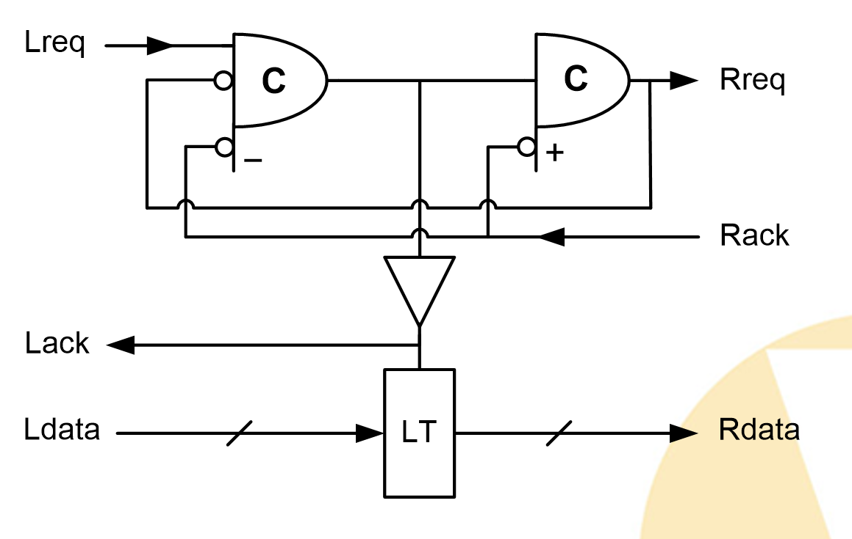
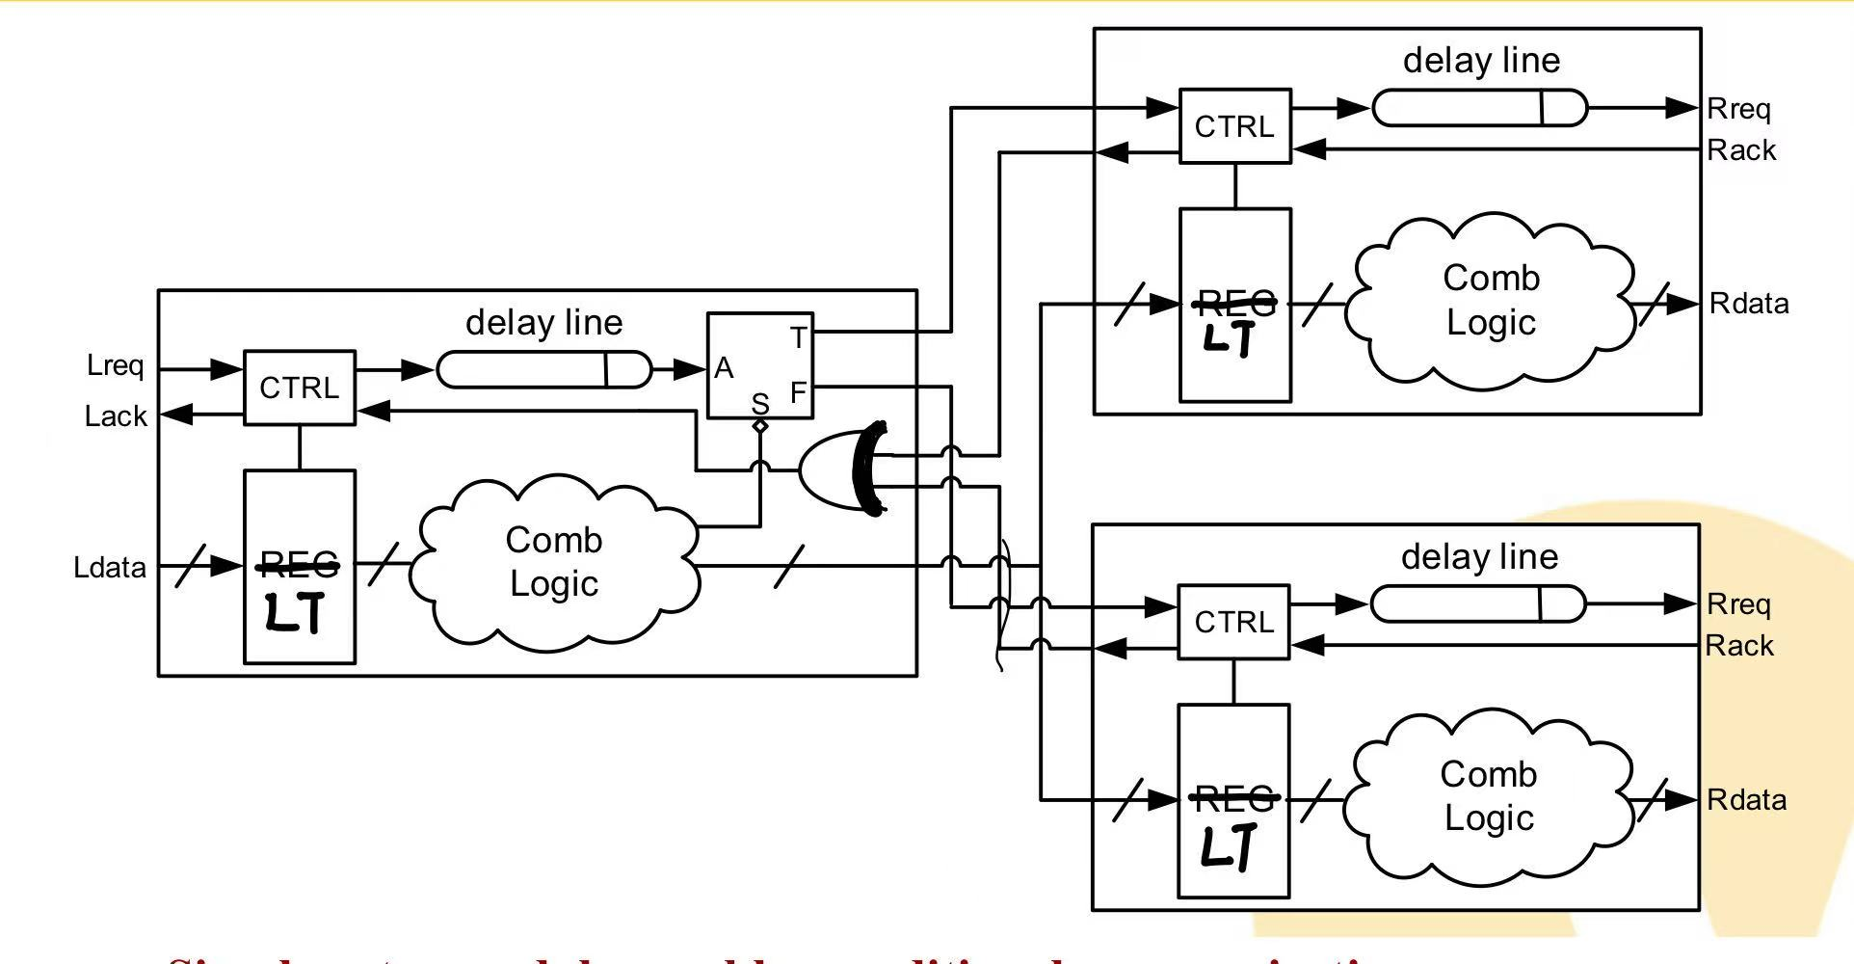
Gate Level Implementation for Input Control
Four-phase Full Buffer
Only send to 1 output control: a split branch
Same output with behavioral implementation

Slide 7
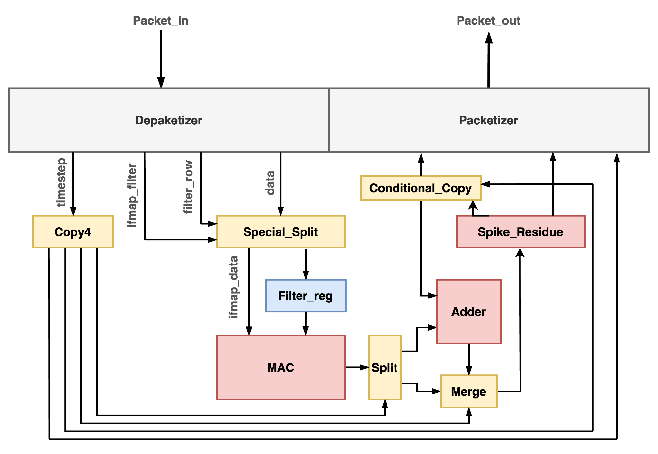
Processing Element
Filter size: 3x3
IFmap size: 4x4
Conv size: 2x2
Filter value reusable

Slide 8
Processing Element
Timestep 1
1.Receive 3x3 filter values(3 packets)
2.Receive 3x3 ifmap values(1 packet)
3.Perform the computation
4.Calculate the outspike and residue
5.Output the packed data
Timestep 2
1.Receive ifmap values(1 packet)
2.Perform the computation
3.Add residue value from timestep1
4.Calculate the outspike and residue
5.Output the packed data

Slide 9
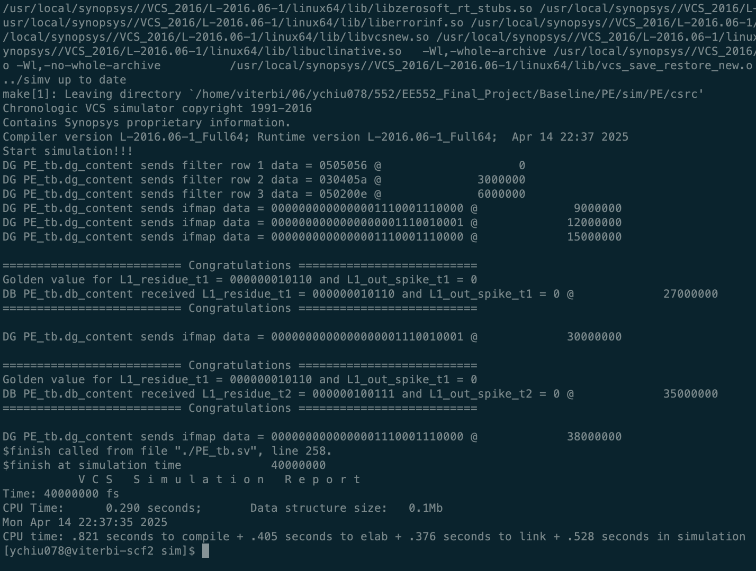
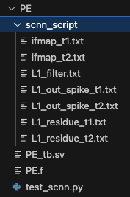
PE Verification
Test Vector & Golden Output Generation
PE Functional Verification Result

Slide 10
Top Module – Tree + PE
Filter size: 3x3
IFmap size: 4x4
Conv size: 2x2

Slide 11
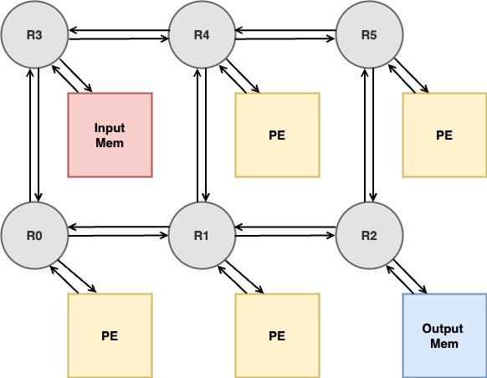
Top Module – Mesh + PE
Filter size: 3x3
IFmap size: 4x4
Conv size: 2x2

Slide 12
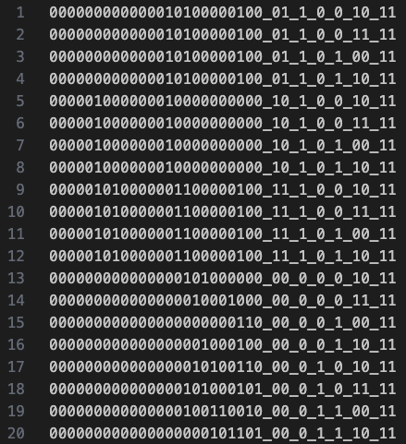
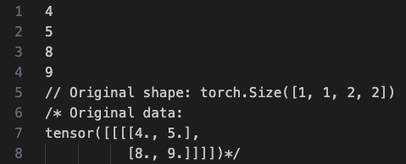
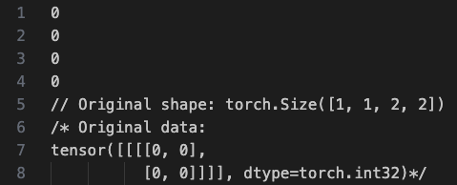
Top Module Verification
Generated Input Packets (Binary Format)
Golden Model Results

Slide 13
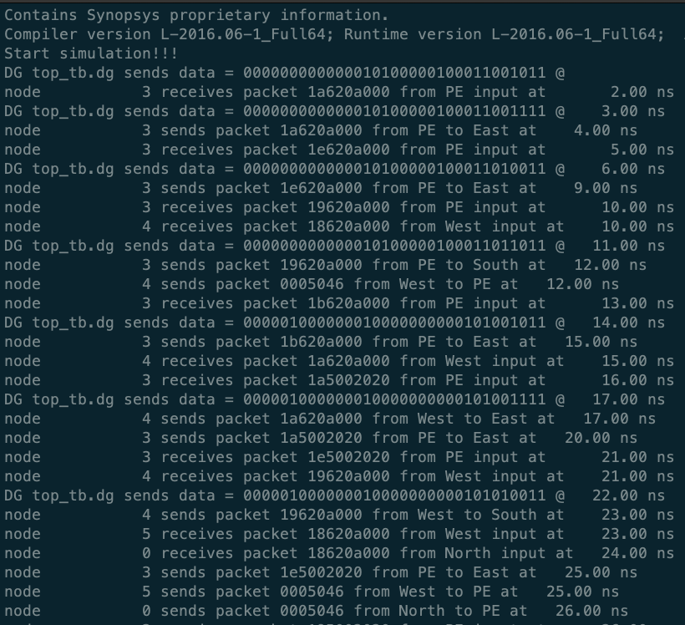
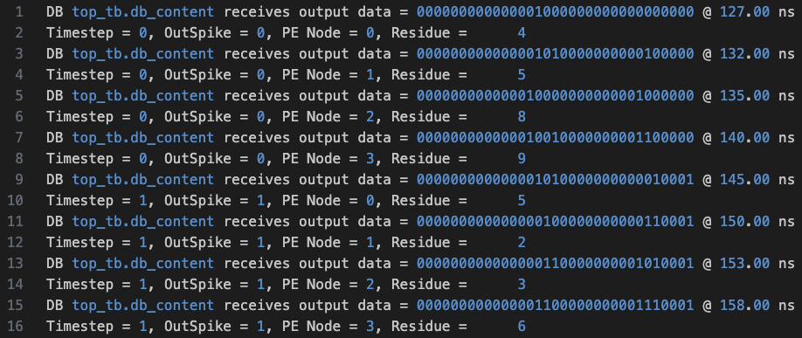
Top Module Verification
Top Module Verification Result
Output Memory Log

Slide 14
Advanced Design

Slide 15
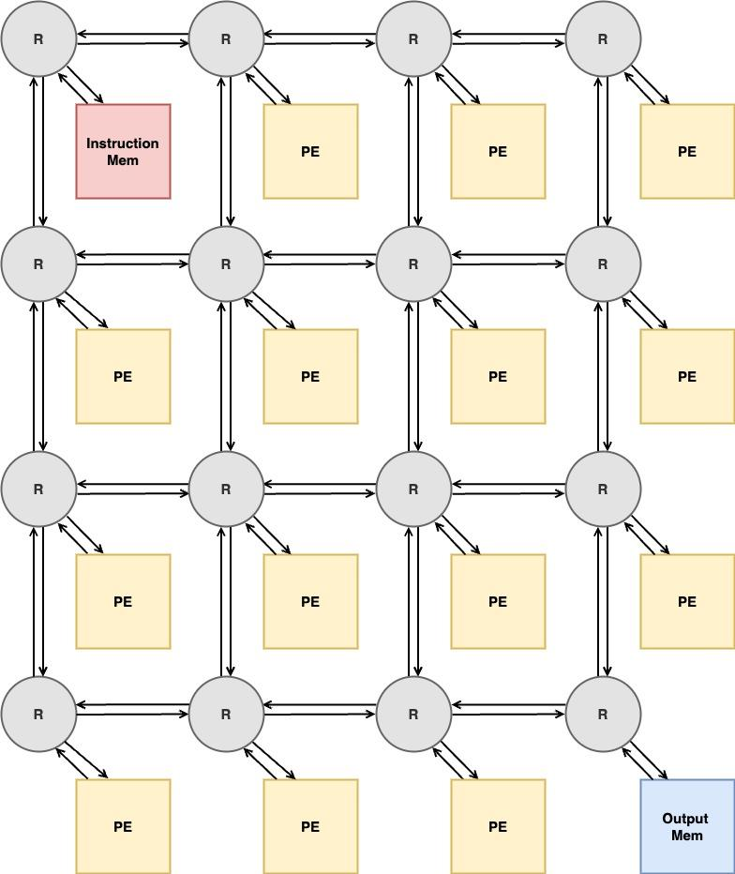
Top Module Specification
Maximum IFmap size: 36x36
Filter size: 2x2-5x5
Maximum Convolution Size: 32x32
Expanded Filter Register and MAC in PE to support flexible filter size
Configurable Sized Mesh
Control Unit: Automatic Instruction Generator

Slide 16
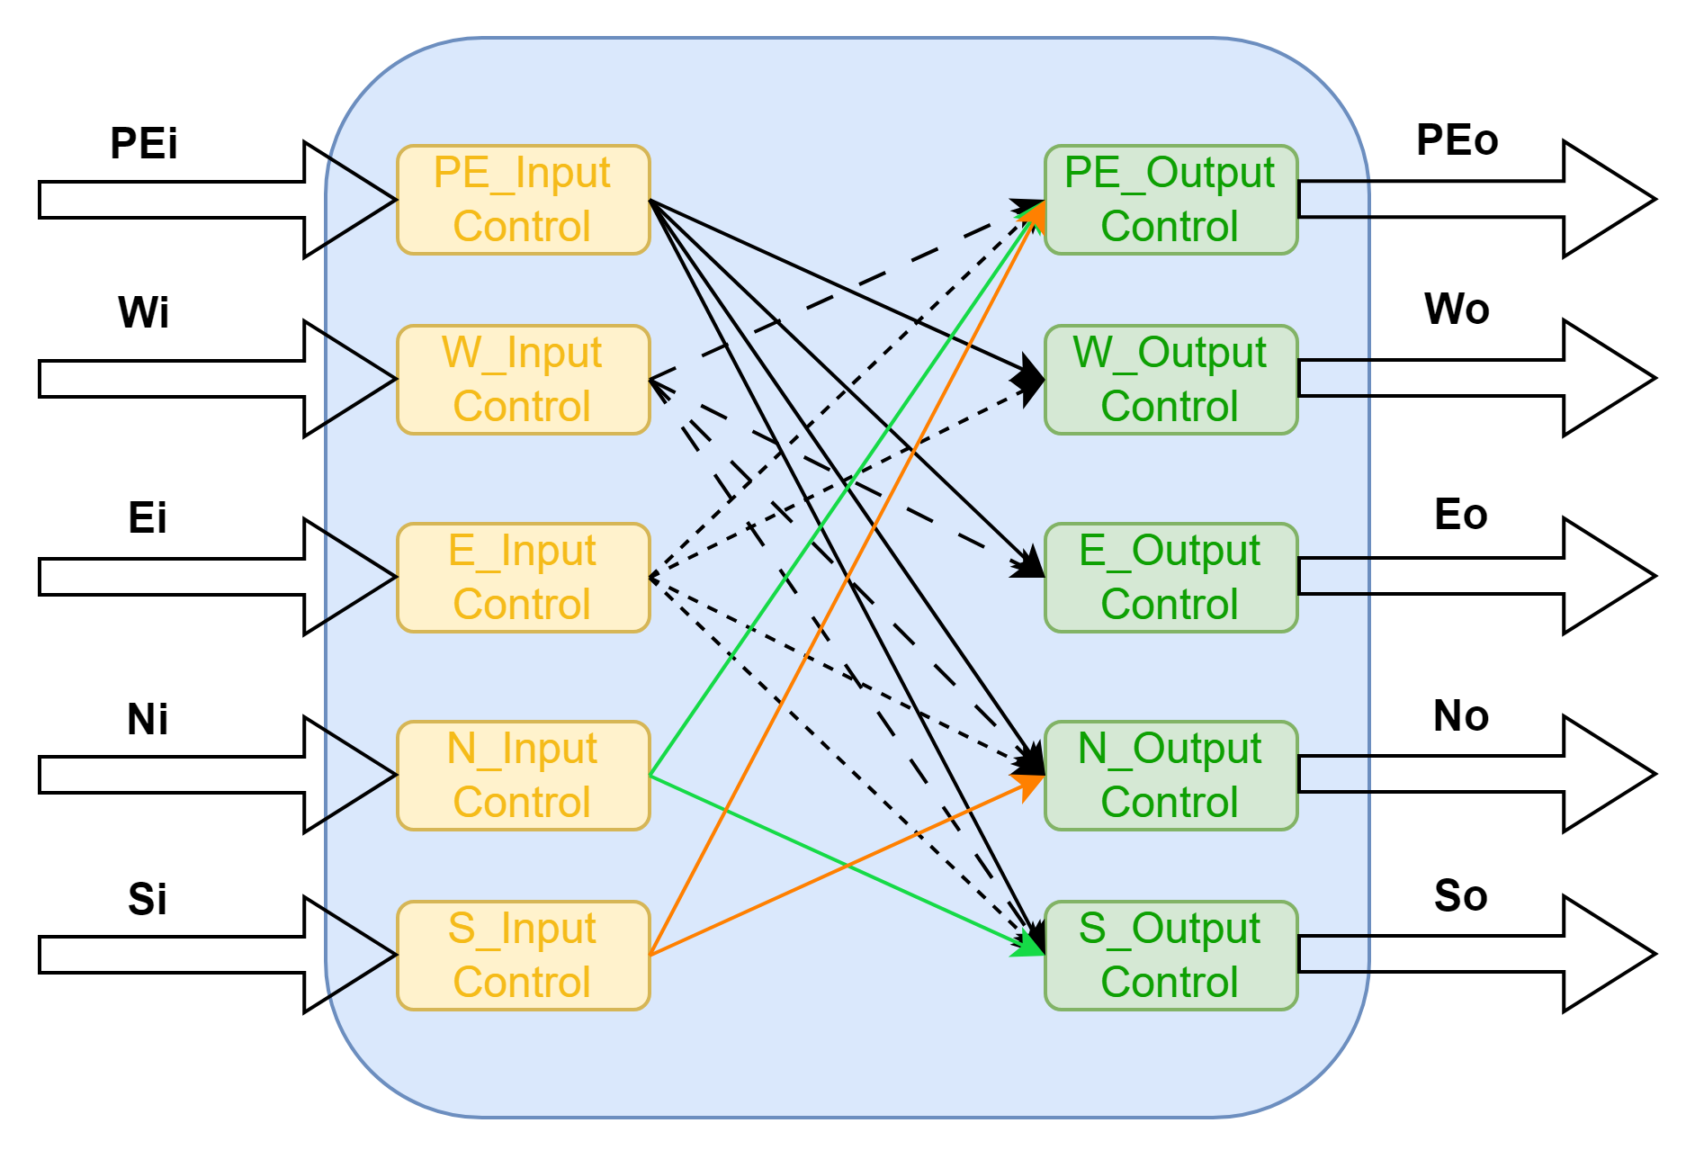
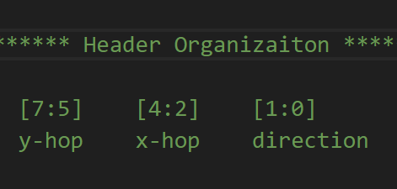
Mesh Topology
XY Routing Algorithm
2 direction bits indicate x and y direction respectively
Hop counts for x and y transfers

Slide 17
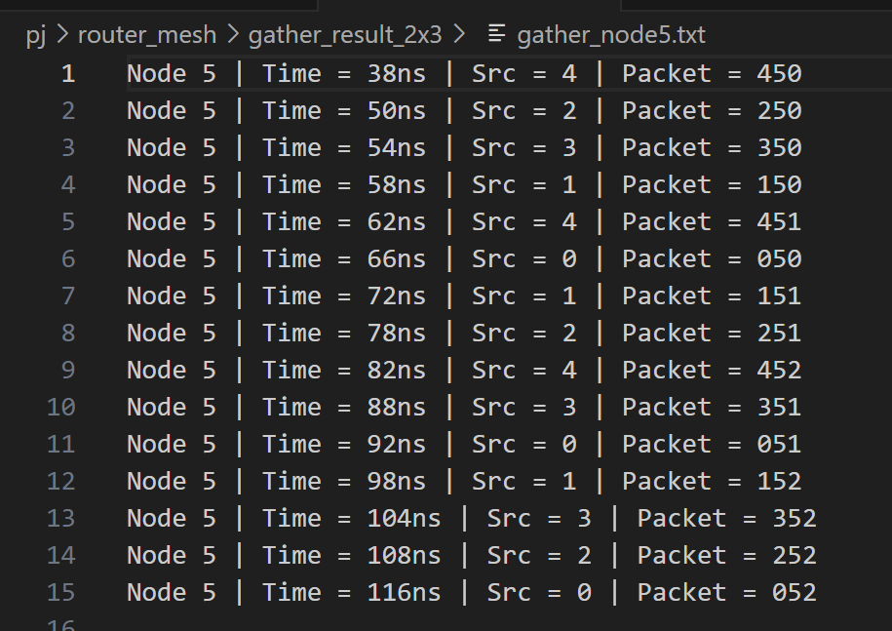
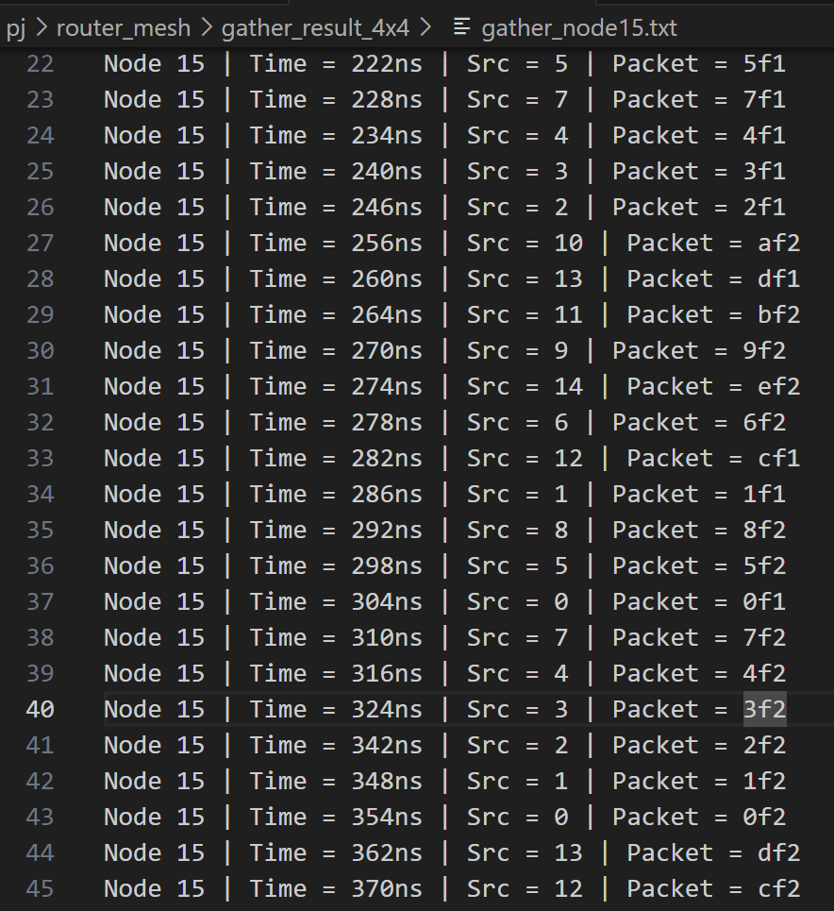
Configurable Mesh: Gather Testbench
2x3 Mesh for Baseline 4x4 Mesh for Advanced
Every node sends 3 packets to
the same destination node

Slide 18
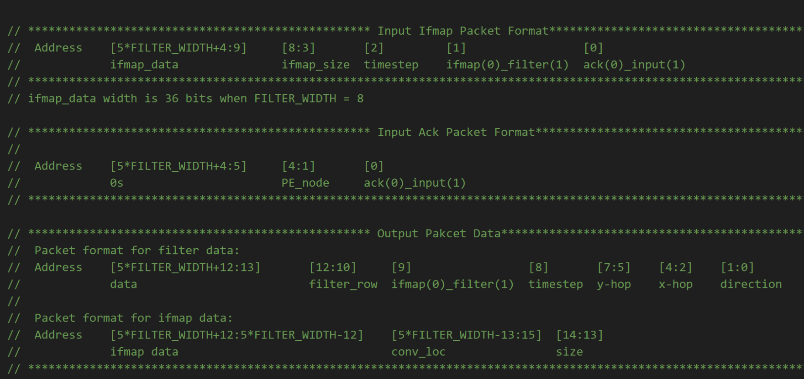
Control-Unit-Packet Format

Slide 19
Control Unit- Filter Instruction Generation
IFmap Memory
PE0_FIFO
IFmap Instruction Generator
Packetizer
PE1_FIFO
Arbiter
I
Instruction Decoder
Allocate
Packet
Done,
Filter row
Filter Instruction Generator
Done, filter inst
O
PE13_FIFO
Packetizer
Filter row,
Filter data
Data
Filter Memory
Filter Memory
Request: Filter row
…
TB
TB
TB

Slide 20
Control Unit- IFmap Instruction Generation
Request: Filter Size, Conv Loc, Timestep
Data
IFmap Memory
PE0_FIFO
Done, Filter Size, Data, Timestep,IFmap size
1
IFmap Instruction Generator
PE nd, IFmap inst
Packetizer
PE1_FIFO
Arbiter
I
Instruction Decoder
Allocate
Packet
Filter Instruction Generator
O
PE13_FIFO
Packetizer
Filter Memory
Filter Memory
…
TB
TB
TB
PE_ack
Filter size

Slide 21
Further Directions
Reuse IFmap Data
Support more timesteps
Support multiple rounds of SCNN calculation

Slide 22
Thank You！

